Slide 1

Analyse von Bolometersignalen der EDELWEISS Dark Matter Suche

Slide 2
Direct detection of WIMPs
(weak interacting massive particles)
WIMP
Scatt. WIMP
Count rate:
< 10⁻² evt/kg/day!
Recoil
nucleus → E_{R} ~10 keV
Challenges:
$α , β, γ$radiation
𝛼 , 𝛽, 𝛾 radiation
neutrons
$μ$ induced events
𝜇 induced events
Ways to go:
low background
powerful background discrimination
background studies

Slide 3
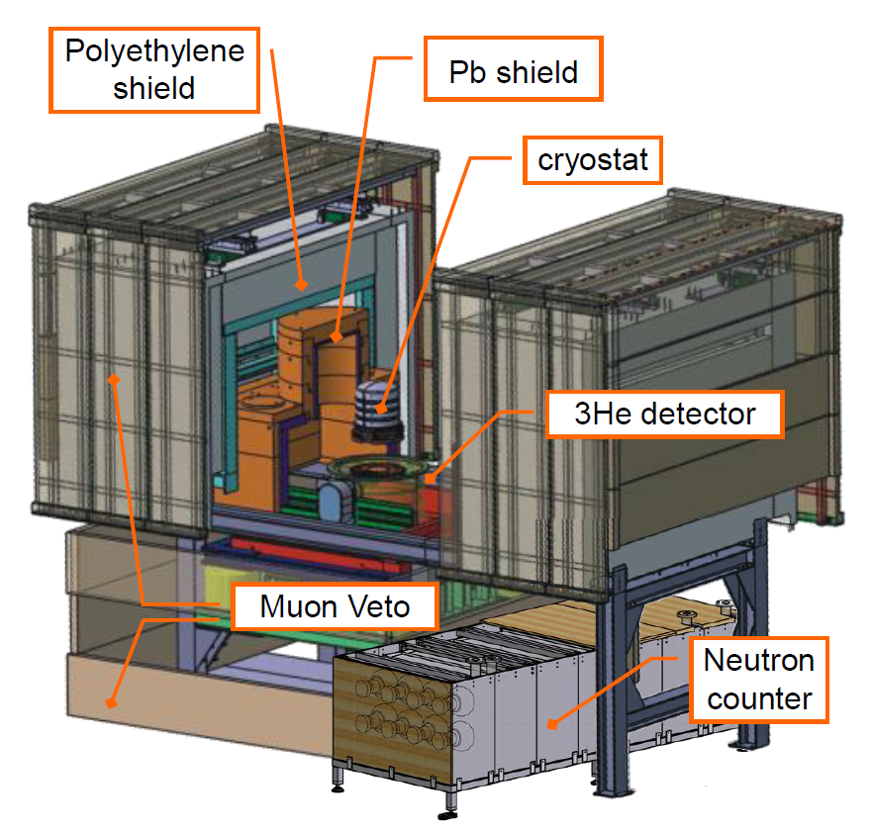
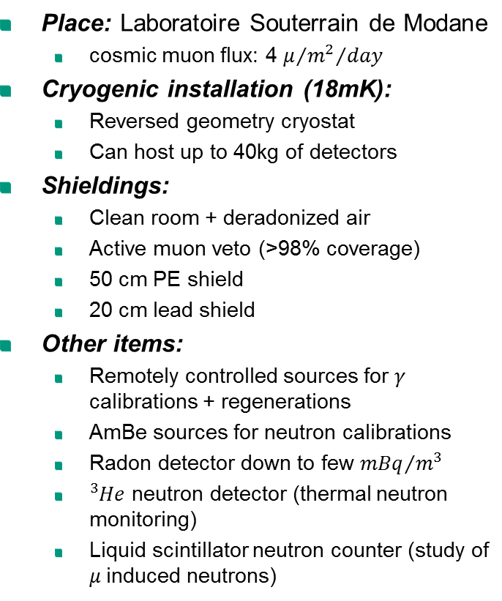
EDELWEISS-II Infrastructure
Place: Laboratoire Souterrain de Modane
  cosmic muon flux: 4 $μ/{{m^{2}}/{day}}$
Cryogenic installation (18mK):
  Reversed geometry cryostat
  Can host up to 40kg of detectors
Shieldings:
  Clean room + deradonized air
  Active muon veto (>98% coverage)
  50 cm PE shield
  20 cm lead shield
Other items:
  Remotely controlled sources for $γ$ calibrations + regenerations
  AmBe sources for neutron calibrations
  Radon detector down to few ${mBq}/{m^{3}}$
  ${}_{}^{3}{He}$ neutron detector (thermal neutron monitoring)
  Liquid scintillator neutron counter (study of $μ$induced neutrons)

Slide 4
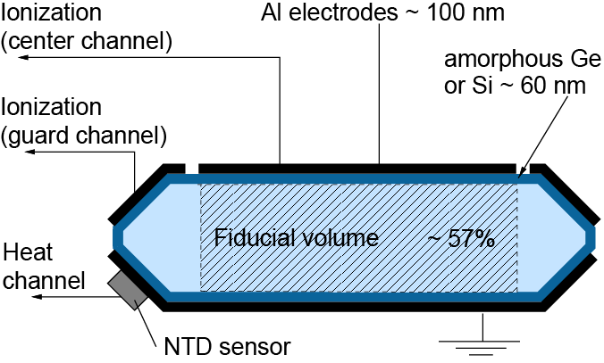
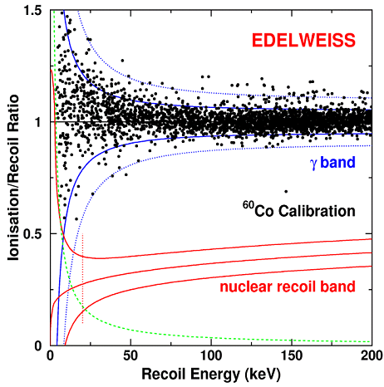
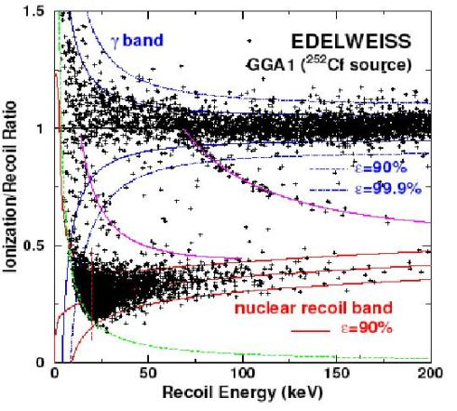

Background rejection with EDELWEISS-I Detectors
Simultaneous measurement of heat and ionization
Event by event $γ$ background rejection by ratio ${{Q=E}_{ion}}/{E_{recoil}}$
  For electron recoil: $Q = 1$
  For nuclear recoil: $Q ≈0.3$

Slide 5
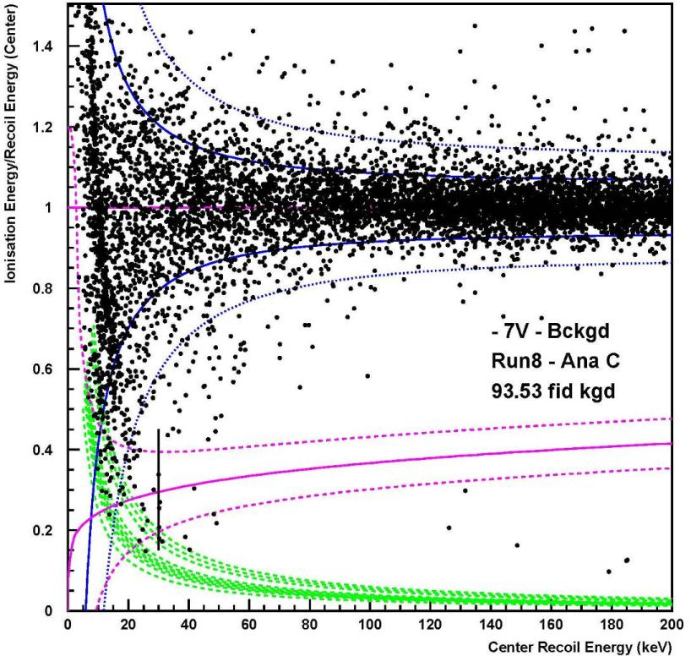

Background rejection with EDELWEISS-I Detectors
EDELWEISS II
93.5 kgd (2008)
Simultaneous measurement of heat and ionization
$γ$ background rejection by ratio ${{Q=E}_{ion}}/{E_{recoil}}$
  For electron recoil: $Q = 1$
  For nuclear recoil: $Q ≈0.3$
Limitations:
Surface events with incomplete charge collection

Slide 6
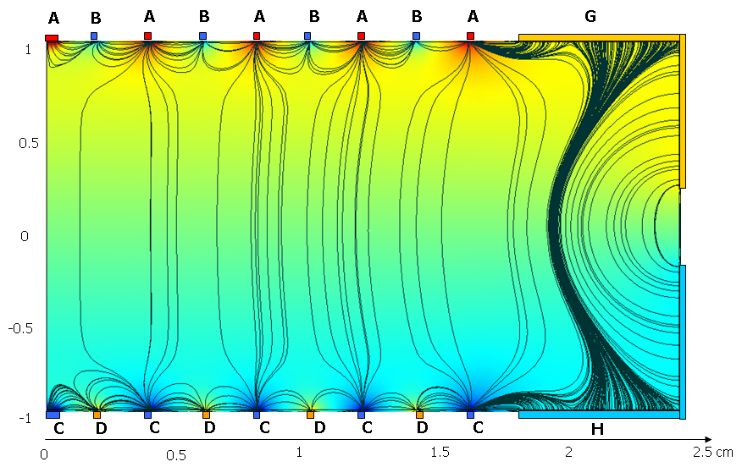
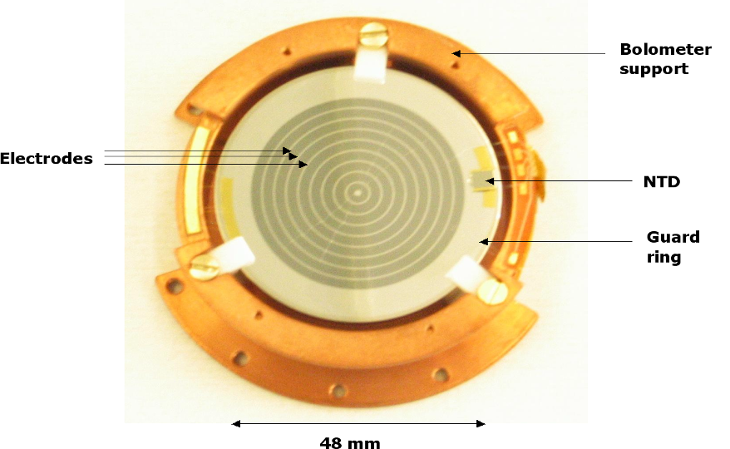
ID detectors: surface event rejection with interleaved electrodes
A: +4 V
B: -1.5V
InterDigitized electrodes (ID):
Modify E-field with biases to be:
  horizontal near surface
  vertical in the bulk
A and C signals as ‚collection‘ electrodes
B and D signals as veto against surface events
Cuts on veto and guard electrodes define the fiducial zone
50 % fid mass
C: -4 V
D: +1.5V

Slide 7
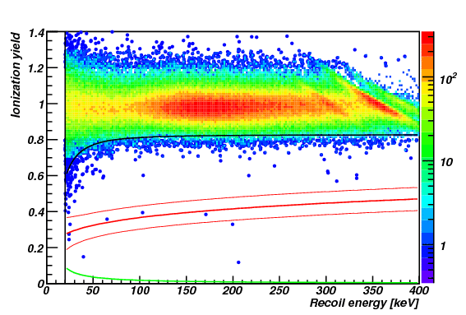
ID detectors: surface event rejection with interleaved electrodes
¹³³Ba calibration data:
fiducial only evts (no signal
observed on veto electrodes)
1.82 x 10⁵ events with
20 < E < 200 keV
6 events (under invest.)
→ rejection factor of
3 x 10⁻⁵ / γ
A: +4 V
B: -1.5V
Modify E-field with biases to be:
  horizontal near surface
  vertical in the bulk
A and C signals as ‚collection‘ electrodes
B and D signals as veto against surface events
Cuts on veto and guard electrodes define the fiducial zone
50 % fid mass
C: -4 V
D: +1.5V

Slide 8
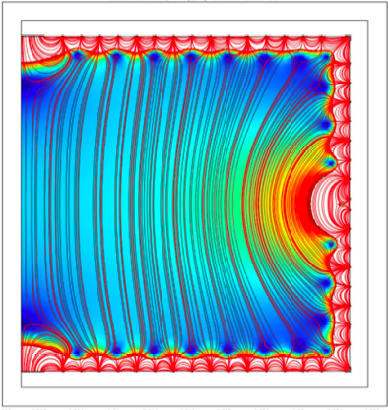
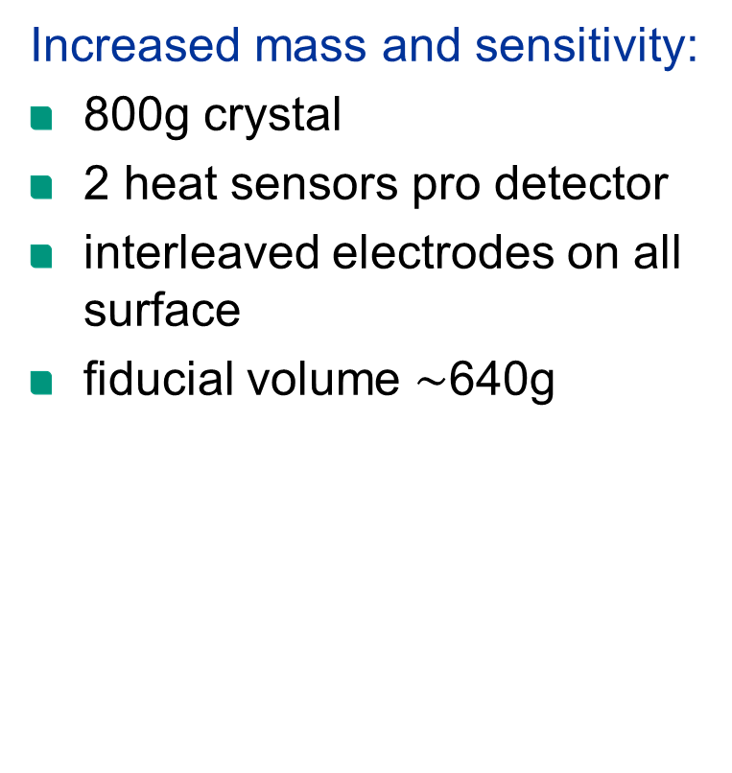
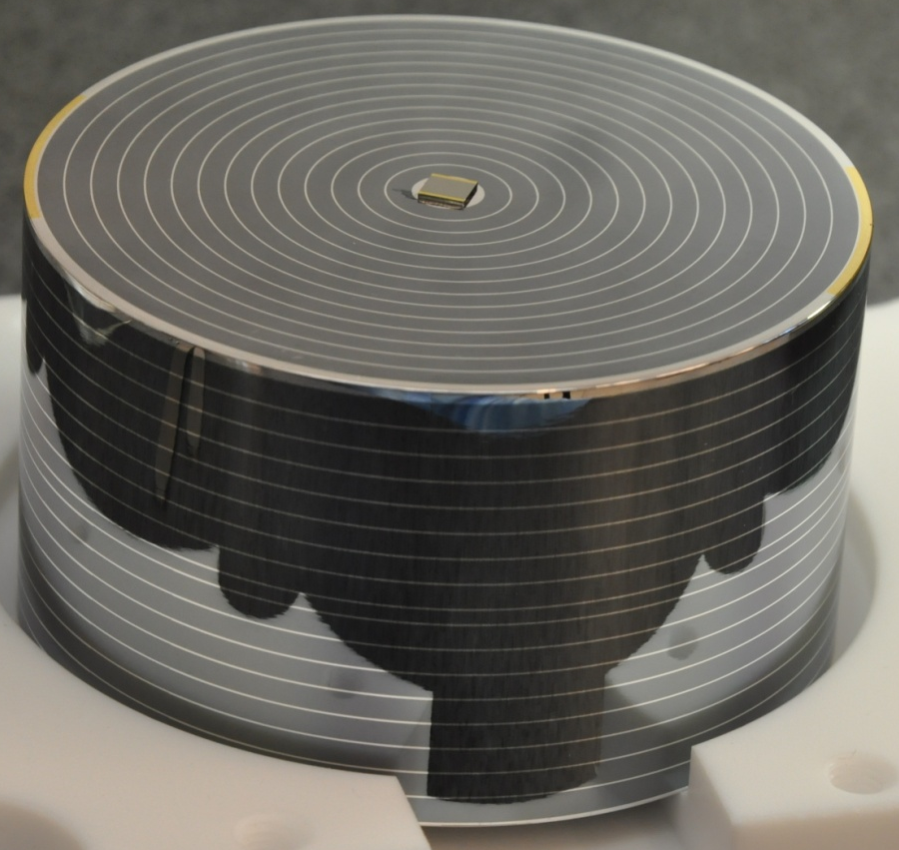
FID800 (Full InterDigitized) detectors
>80% fid mass

Slide 9
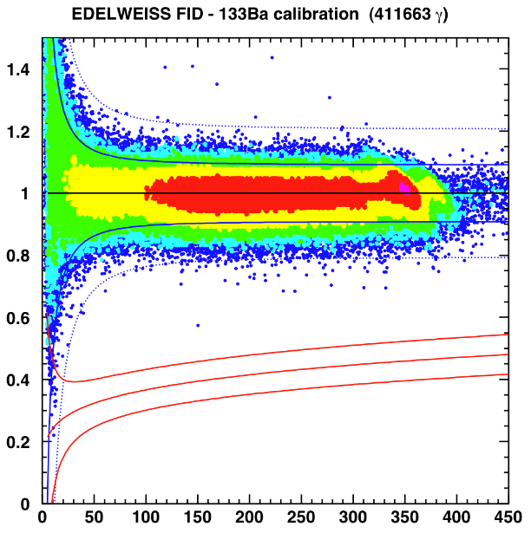
FID800 detector performance
No events in the nuclear recoil band!
Increased mass and sensitivity:
800g crystal
2 heat sensors pro detector
interleaved electrodes on all surface
fiducial volume $\sim$640g
>80% fid mass
Ge-ID (350000 γ)
Ge-FID800 (412000 γ)

Slide 10
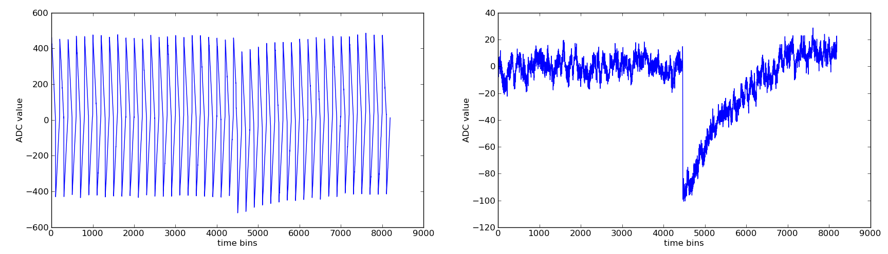
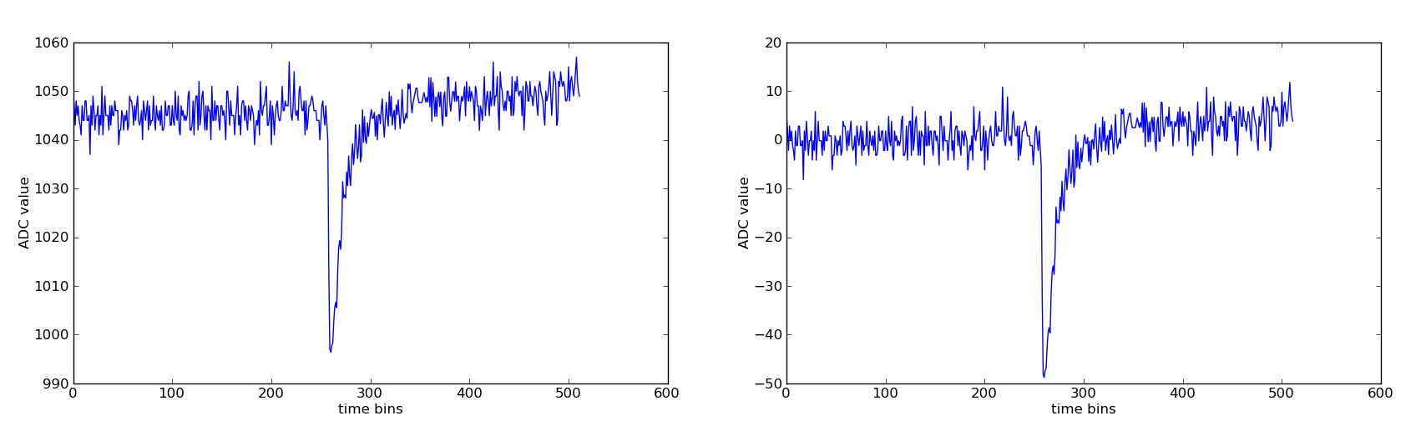
Bolometer signals
raw ionisation trace with heat channel crosstalk
after subtraction of pattern and baseline
raw heat trace
after baseline subtraction

Slide 11
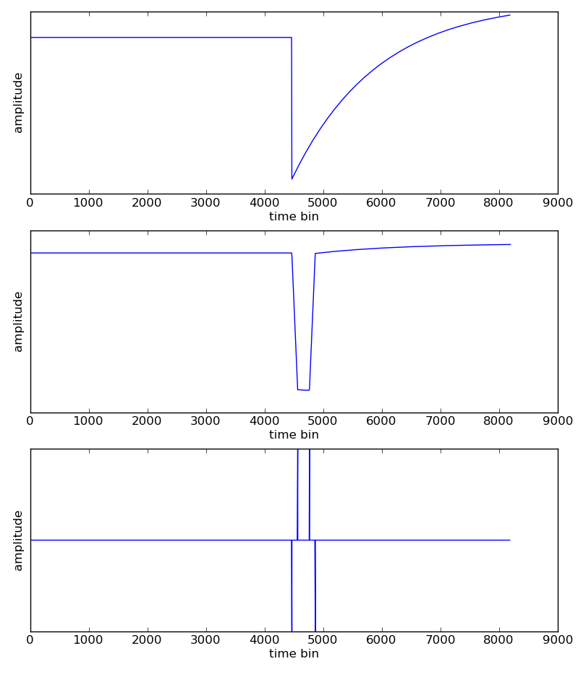
Trapezoidal Filter
transforms exponentional pulse with known fall time into trapezoid
rise time and flat top width are set by filter parameters
second derivative has a characteristic pattern

Slide 12
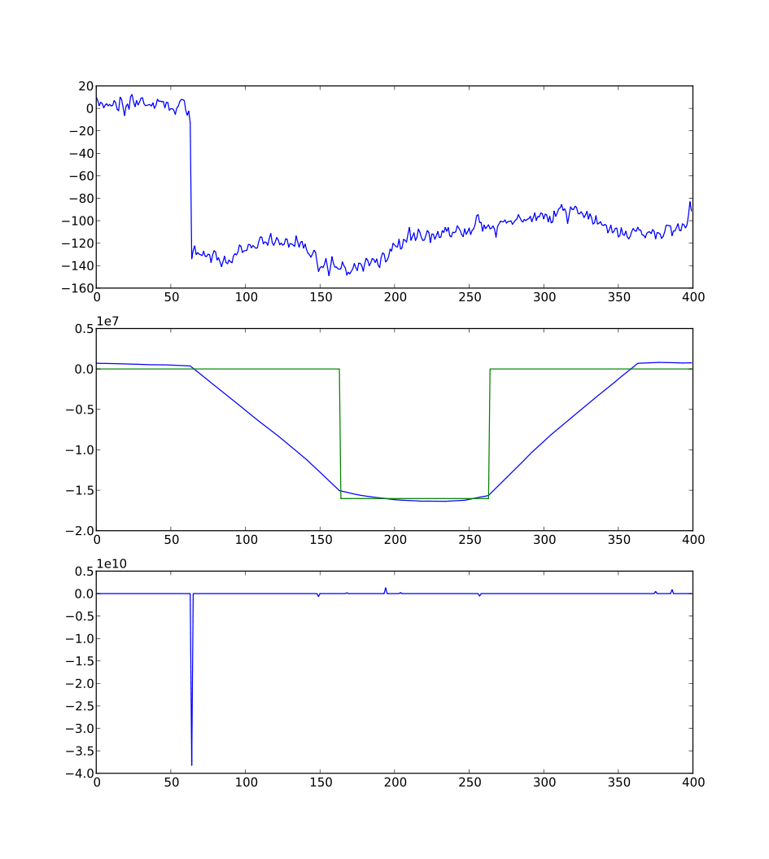
Using trapezoidal filter
peak amplitude is 15*RMS(noise sample)
estimation of amplitude by calculating the mean of the flat top
estimation of peak position by calculating the correlation of second derivative of the filter output with the characteristic pattern

Slide 13
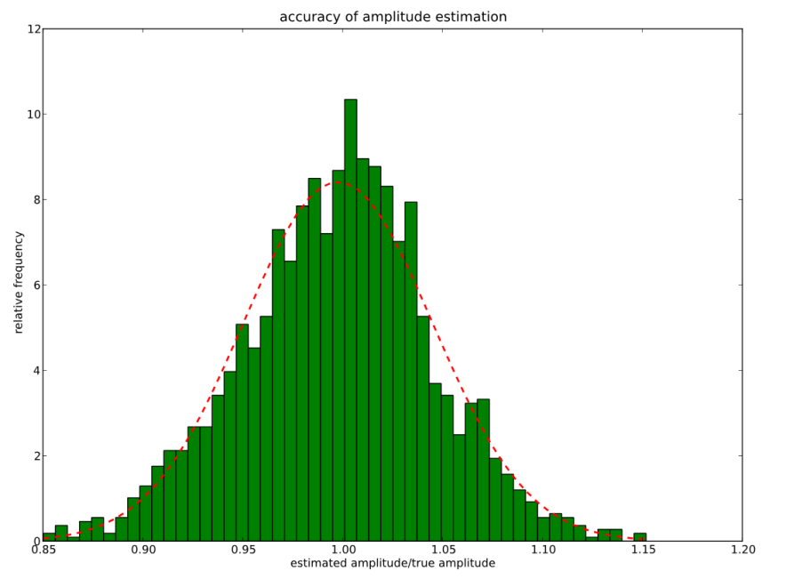
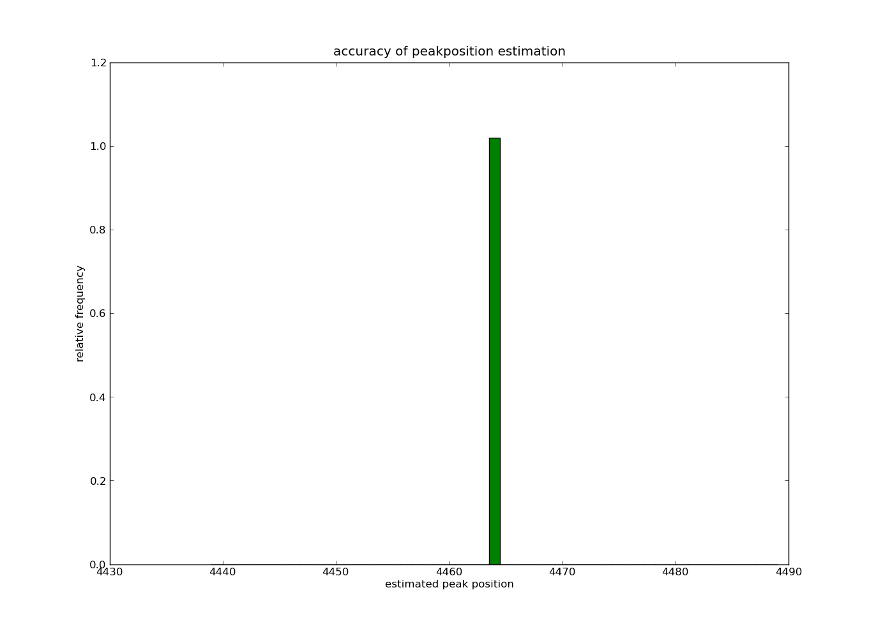
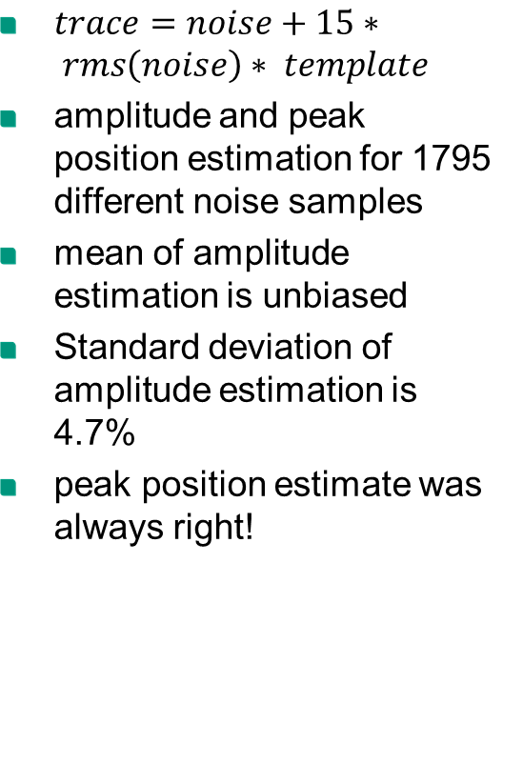
Accuracy of trapezoidal filter
$trace=noise+15∗ rms\left(noise\right)∗ template$
amplitude and peak position estimation for 1795 different noise samples
mean of amplitude estimation is unbiased
Standard deviation of amplitude estimation is 4.7%
peak position estimate was always right!

Slide 14
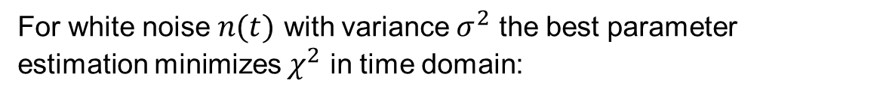
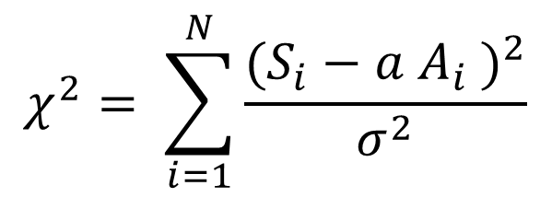
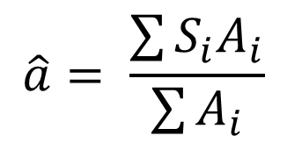

Time Domain Fitting
Measured signal:
Expected signal at input
$$S\left(t\right)=a A\left(t−t_{0}\right)+n(t)$$
Amplitude
Pulse start time
Noise
For white noise $n(t)$ with variance $σ^{2}$ the best parameter estimation minimizes $χ^{2}$ in time domain:
$$χ^{2}= \sum_{i=1}^{N}{\frac{{(S_{i}−a A_{i} )}^{2}}{σ^{2}}}$$
$$\hat{a}= \frac{\sum{S_{i}A_{i}}}{\sum{A_{i}}}$$
minimal at:

Slide 15
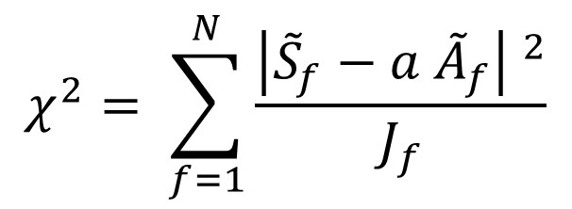
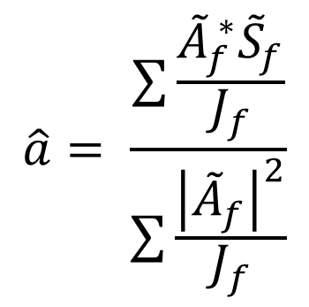
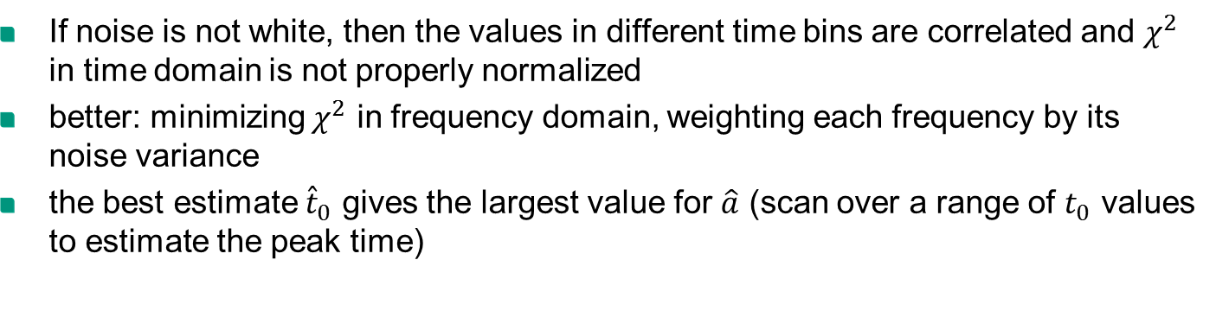
Optimal Filtering
If noise is not white, then the values in different time bins are correlated and $χ^{2}$ in time domain is not properly normalized
better: minimizing $χ^{2}$ in frequency domain, weighting each frequency by its noise variance
the best estimate ${\hat{t}}_{0}$ gives the largest value for $\hat{a}$ (scan over a range of $t_{0}$ values to estimate the peak time)
$$\hat{a}= \frac{\sum{\frac{{\tilde{A}}_{f}^{ ∗}{\tilde{S}}_{f}}{J_{f}}}}{\sum{\frac{{\left|{\tilde{A}}_{f}\right|}^{2}}{J_{f}}}}$$
$$χ^{2}= \sum_{f=1}^{N}{\frac{{\left|{\tilde{S}}_{f}−a {\tilde{A}}_{f}\right| }^{2}}{J_{f}}}$$
minimal at:
Average noise power spectral density

Slide 16
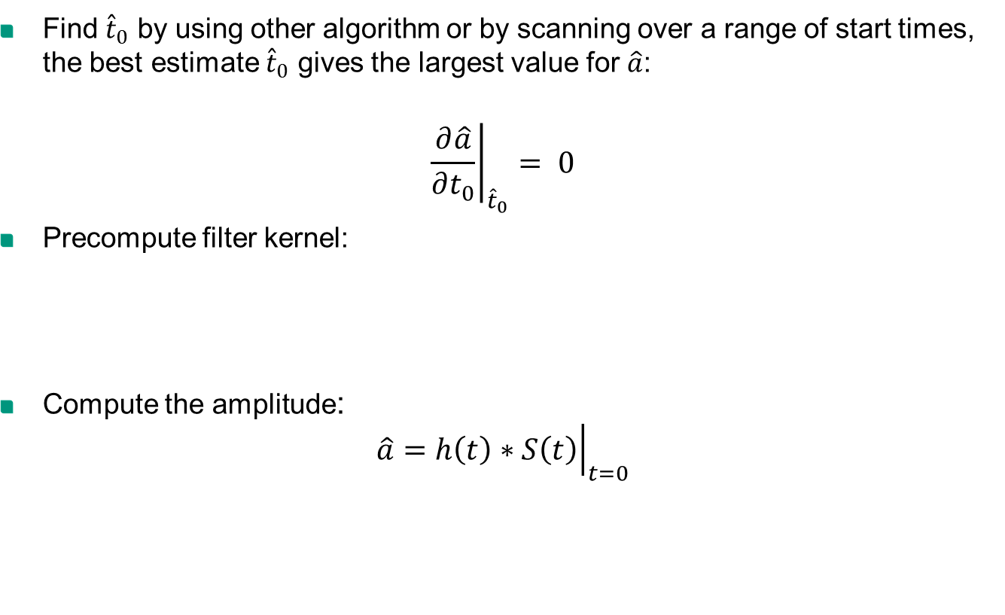

Applying Optimal Filter
Find ${\hat{t}}_{0}$ by using other algorithm or by scanning over a range of start times, the best estimate ${\hat{t}}_{0}$ gives the largest value for $\hat{a}$:
$${\left.\frac{∂\hat{a}}{∂t_{0}}\right|}_{{\hat{t}}_{0}}= 0$$
Precompute filter kernel:
Compute the amplitude:
$$\hat{a}={\left.h\left(t\right)∗S\left(t\right)\right|}_{t=0}$$
$$\tilde{h}\left(f\right)=\frac{\frac{{\tilde{A}}_{f}^{ ∗}}{J_{f}}}{\sum{\frac{{\left|{\tilde{A}}_{f}\right|}^{2}}{J_{f}}}}$$

Slide 17
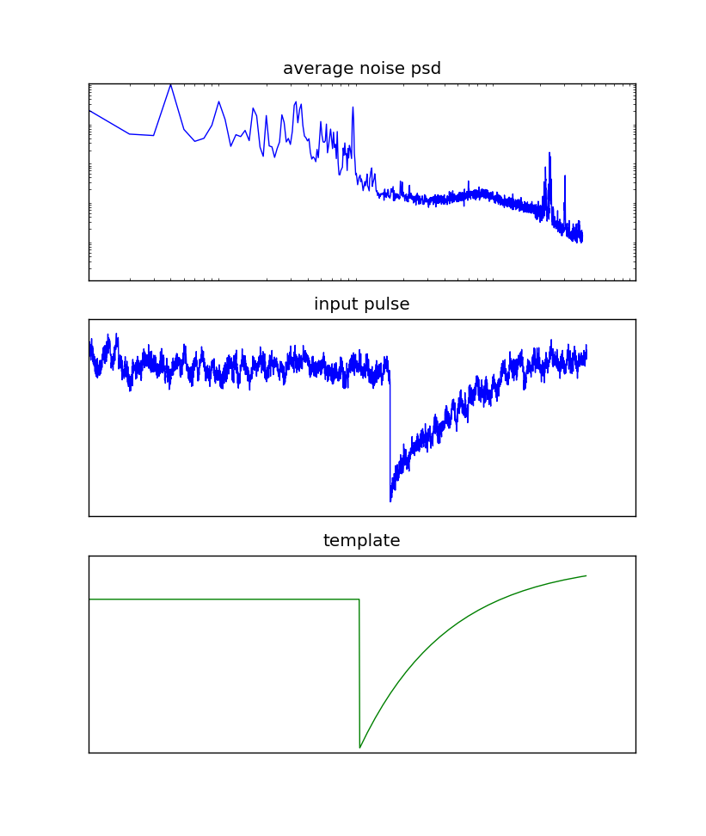
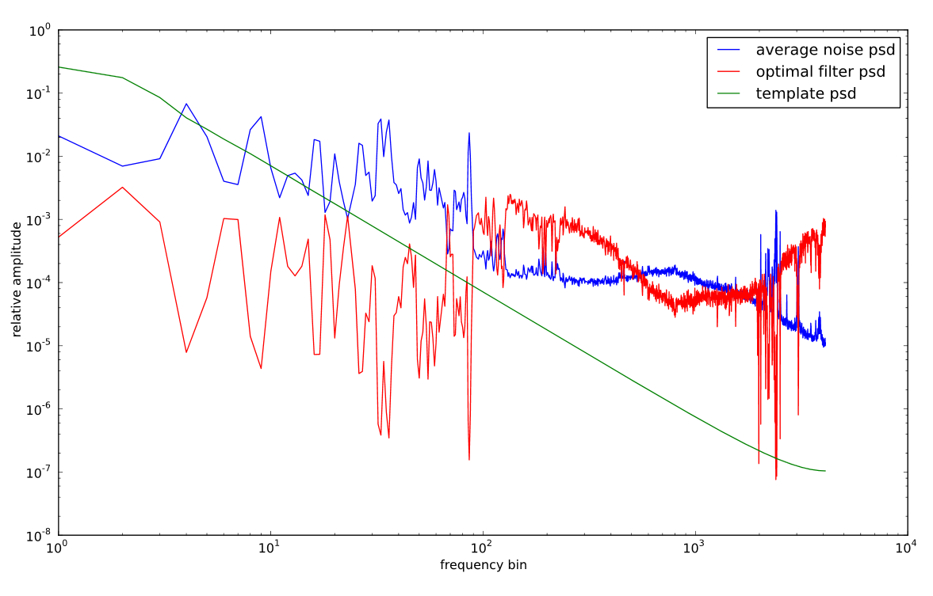
Applying Optimal Filter
amplitude
peak time

Slide 18
Conclusions & outlook
trapezoidal filter:
optimal filter:
robust
precise reconstruction of position
amplitude spreading o(5%) for large signals
not optimally filtering the noise
weighting the allowed frequencies depending on the noise
optimal discrimination signal-to-noise in frequency domain
depends on correct model of noise frequency spectrum
modified optimal filter used so far in Edelweiss-2
full optimal filter under investigation

Slide 19
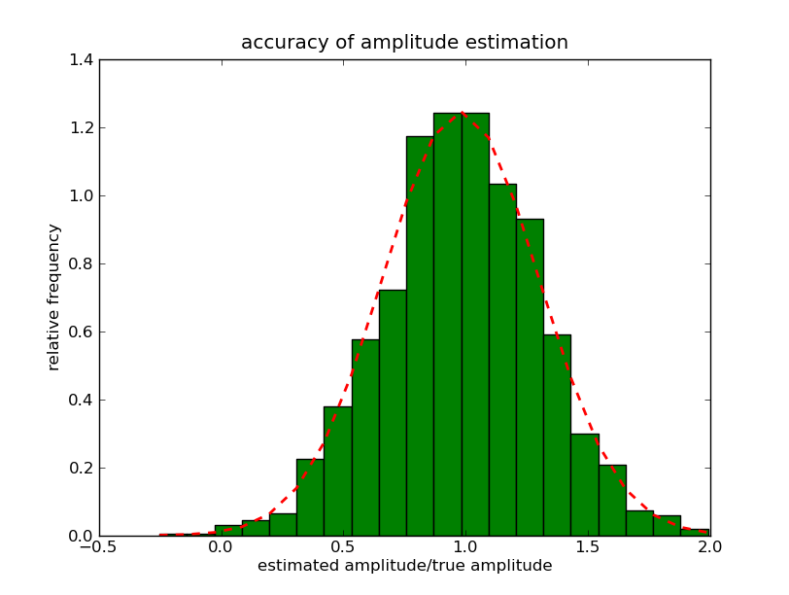
Conclusions & outlook
optimal filter:
weighting the allowed frequencies depending on the noise
optimal discrimination signal-to-noise in frequency domain
depends on correct model of noise frequency spectrum
modified optimal filter used so far in Edelweiss-2
full optimal filter under investigation
Preliminary!

Slide 20
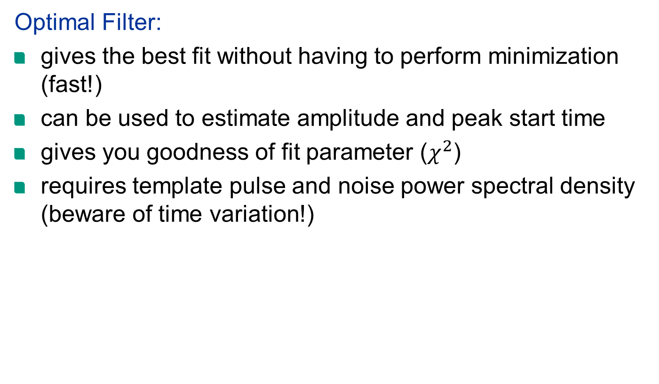
Conclusions & outlook

Slide 21
Conclusions
Optimal Filter:
gives the best fit without having to perform minimization (fast!)
can be used to estimate amplitude and peak start time
gives you goodness of fit parameter ($χ^{2}$)
requires template pulse and noise power spectral density (beware of time variation!)
Preliminary!

